Slide 1
Network Security
Introduction
Lecture 2

Slide 2
Learning Objective
Introduce the security requirements
confidentiality
integrity
availability
Describe the X.800 security architecture for OSI
Explain the fundamental security design principles

Slide 3
Computer Security Concepts

Slide 4
Computer Security
Definition: The protection afforded to an automated information system in order to attain the application objectives to preserving the integrity, availability, and confidentiality of information system resources (includes hardware, software, firmware, information/data, and telecommunications).
- NIST Computer Security Handbook

Slide 5
Confidentiality
Data confidentiality: Assures that private or confidential information is not made available or disclosed to unauthorized individuals;
Privacy: Assures that individual's control or influence what information related to them may be collected and stored and by whom and to whom that information may be disclosed
i.e., student grade information

Slide 6
Integrity
Data integrity: Assures that data (both stored and in transmitted packets) and programs are changed only in a specified and authorized manner;
System integrity: Assures that a system performs its intended function in an unimpaired manner, free from deliberate or inadvertent unauthorized manipulation of the system
i.e., a hospital patient’s allergy information

Slide 7
Availability
Availability: Assures that systems work promptly, and service is not denied to authorized users, ensuring timely and reliable access to and use of information
i.e., denial of service attack

Slide 8
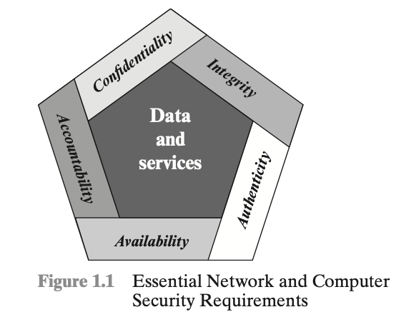
Other security requirements
Authenticity
Accountability
tracible data source,
fault isolation
intrusion detection and prevention,
recovery and legal action
system must keep records of their activities to permit later forensic analysis to trace security breaches or to aid in transaction disputes

Slide 9
Question
What security requirements does a blockchain system have achieved?

Slide 10
Challenges to achieve a secure system
The mechanisms used to meet those requirements can be quite complex, and understanding them may evolve rather subtle reasoning
When developing security mechanisms, must always consider potential attacks
Sometimes, security mechanisms are counterintuitive
Where to use them?
Involve more than a particular algorithm or protocol
No agreement on security for complex and heterogeneous systems i.e. trusts on data in different countries
etc.

Slide 11
OSI Security Architecture

Slide 12
OSI Security Architecture
International Telecommunication Union – Telecommunication (ITU-T) recommends X.800
Security Architecture for Open Systems Interconnection (OSI)
Defines a systematic way of defining and providing security requirements
Used by IT managers and vendors in their products
Security attacks
Security mechanisms
a process (or a device incorporating such a process) to detect, prevent, or recover from an attack
Security services
enhances the security of the data processing systems and the information transfers, such as policies

Slide 13
Email communication
Email subject: course# _ section_course name_reason
such as “CS 5342_s01_network security_late submission”

